Slide 1

Individual Activity
Find relevant drawings and information of the chosen case study.
- share via e Portfolio

Slide 2

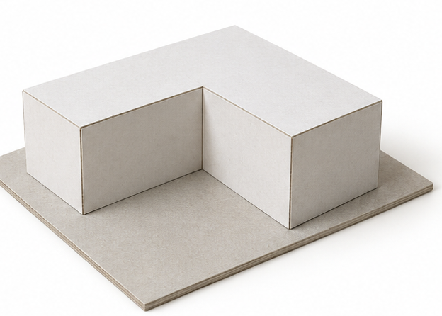
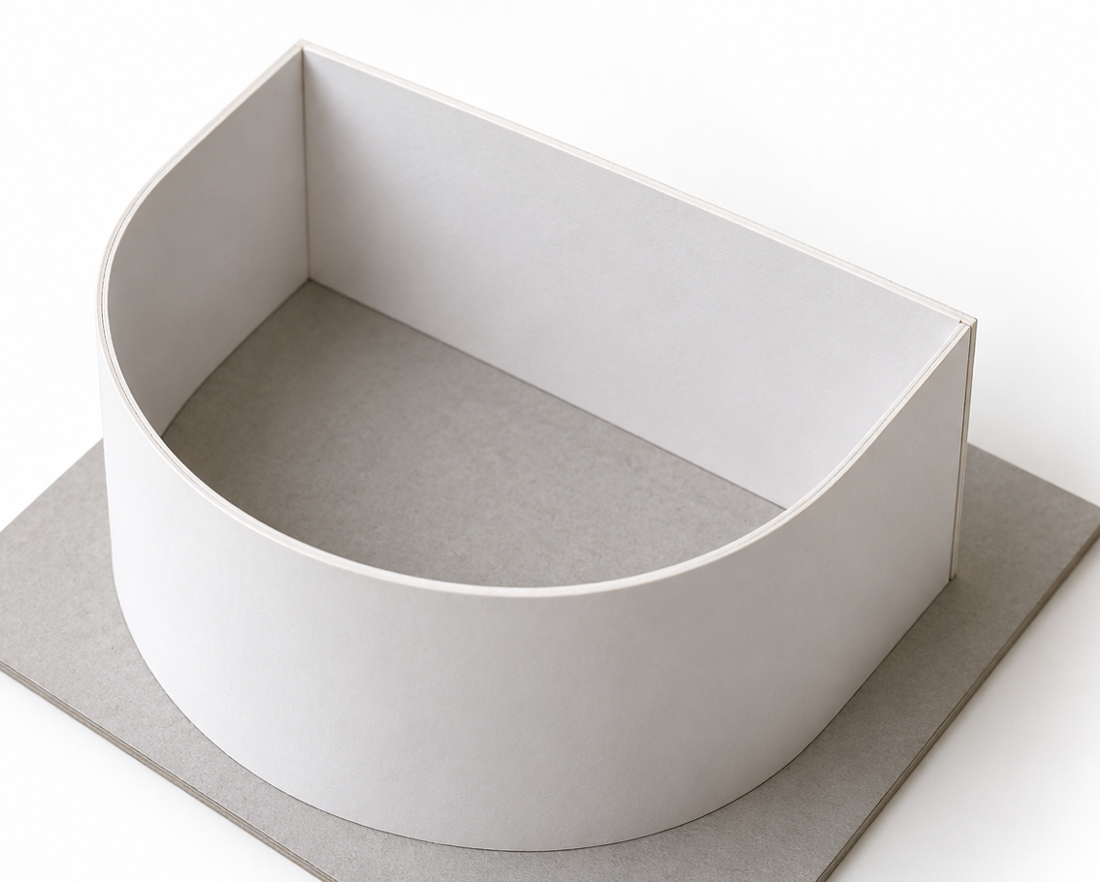
Group Activity
Making Simple models with different materials.

Slide 3
Group Activity
Group discussion about their modelling materials and themes

Slide 4
Group Activity
Student presentation of chosen modelling materials and group modelling themes by Indesign.

